Slide 1
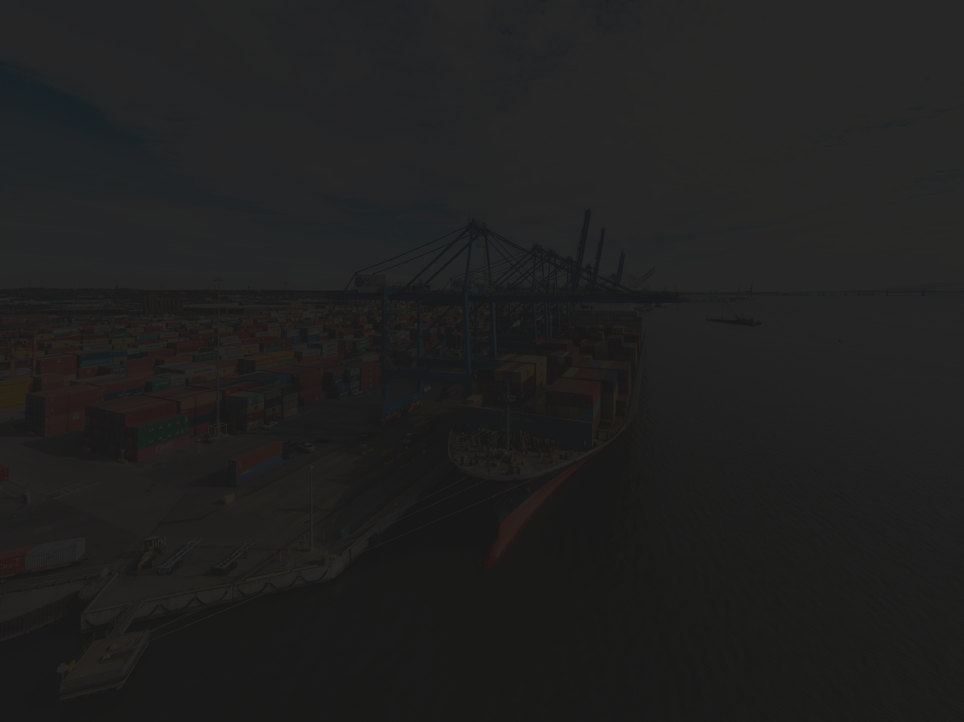




BACHELOR THESIS
EDI INTEGRATION MANAGER
FOR INTERCHANGE MESSAGE PROCESSING
Supervisor: Lect. Dr. Tudor-Dan Mihoc
Author: Iaguța Alen-Mihael

Slide 2
AGENDA
01
INTRODUCTION TO EDI
02
MOTIVATION
03
APP IMPLEMENTATION
04
CONCLUSIONS & FURTHER WORK
05
LIVE DEMO

Slide 3
WHAT IS EDI ?
ELECTRONIC DATA INTERCHANGE
WHY SHOULD WE USE IT ?
Exchange of electronic data between companies
using precisely defined transactions, using a set of standards for structuring information
Speed: Data can be moved with little to no delay
Accuracy: Errors are reduced
Simplicity: EDI Standards specify how the data is formatted and where it is located
Security: EDI documents can be accesed only by authorized users and the data can be formatted by choice
WHERE IS IT BEING USED ?
EDI is used across a wide range of industries to streamline and automate the exchange of business documents for:
Retails, Automotive, Logistics & Transportation, Healthcare, Finance, etc.

Slide 4
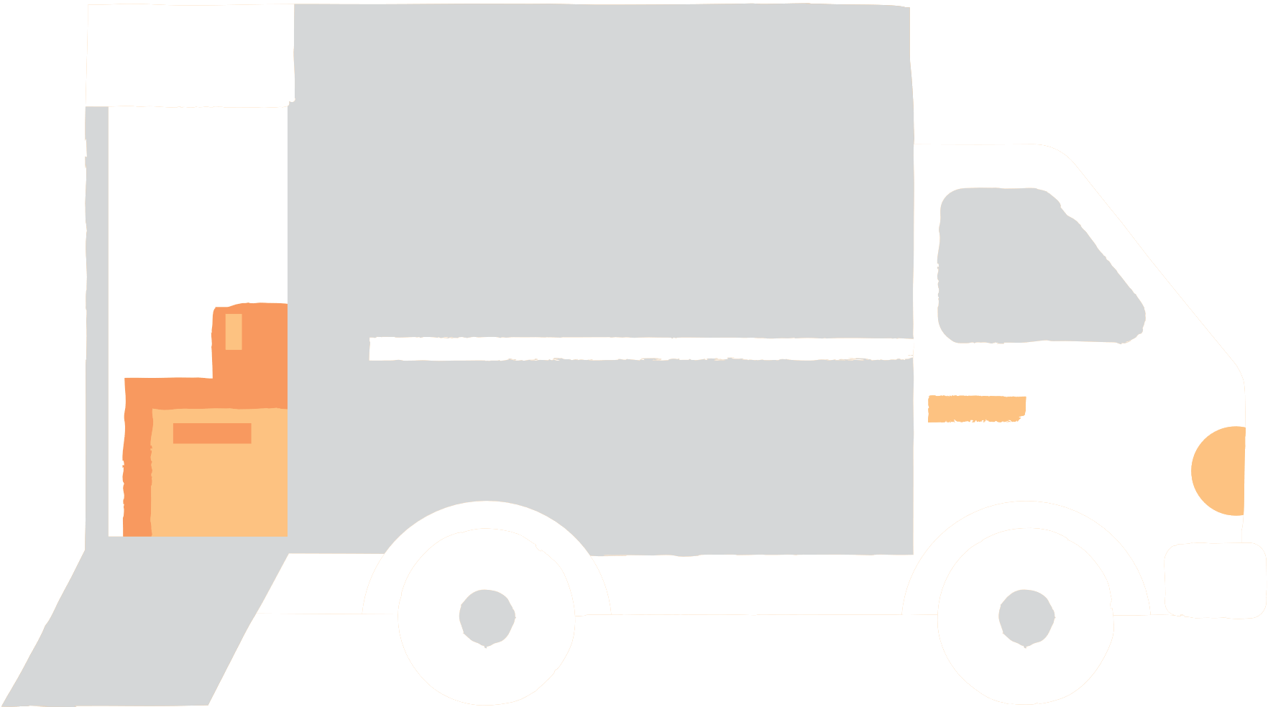


HOW DOES IT WORK ?
TRANSFER OF PHYSICAL PRODUCT
RECEIVE ITEMS
SEND ITEMS
BAR CODES/LABELS USED TO
VERIFY ITEMS RECEIVED
EDI (TRANSFER OF DOCUMENTS)
BAR CODES/LABELS USED TO
RECORD ITEMS SHIPPED
CUSTOMER
STEP 1. PROPOSAL
SUPPLIER
STEP 2. SIGNED CONTRACT
STEP 3. SHIPPING DOCUMENTS & INVOICE
STEP 4.
APPROVE
PAYMENT
STEP 6.
NOTICE OF
DEPOSIT
CUSTOMER’S BANK
SUPPLIER’S BANK
STEP 5. ELECTRONIC FUNDS TRANSFER

Slide 5



MOTIVATION
01
02
03
Working in the EDI integration field has motivated me
to create a tool that reflects both
my professional experience and personal interest in
solving real-world data exchange challenges.
I built this solution to help small and medium-sized
companies
that are looking to expand but may hesitate to adopt EDI
due to
the uncertainty of using prematurely paid services.
I wanted to lower the technical barrier to entry
by offering a straightforward
and accessible platform that encourages
businesses to adopt
modern integration practices with confidence.

Slide 6

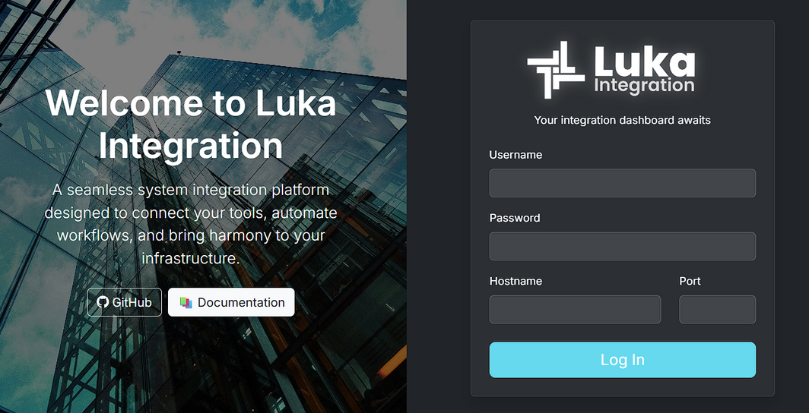
APP IMPLEMENTATION
The application is a web-based platform where multiple clients can connect to a centralized server for real-time data exchange and EDI processing.

Slide 7
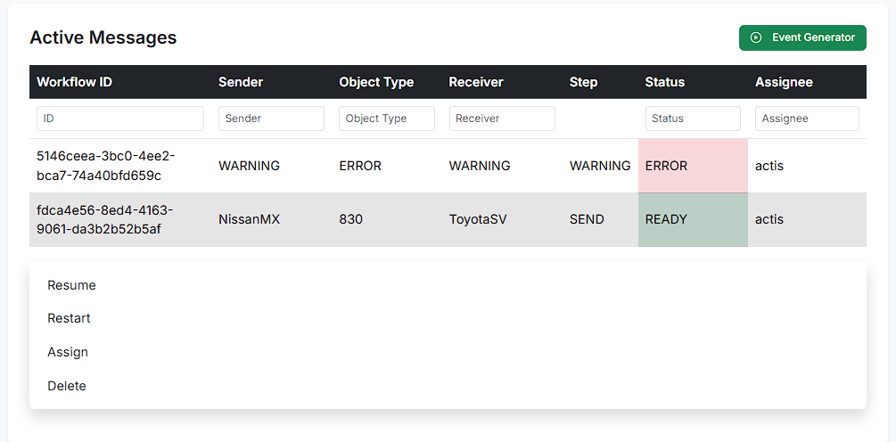
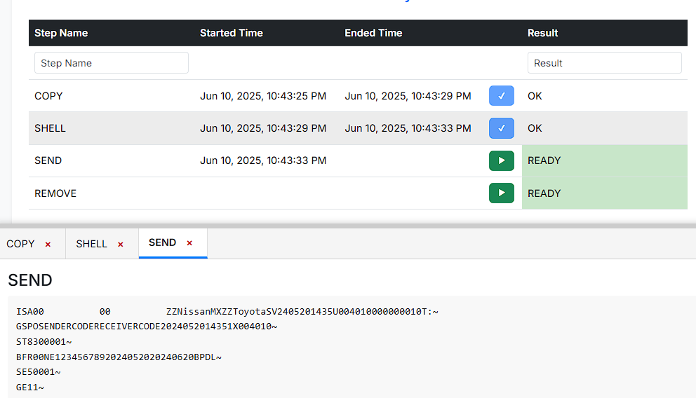
The application relies on:
Managing EDI files and documents, in order to ensure organization
Create custom workflows for documents to go through
Ensure and manage the processing of the files

Slide 8
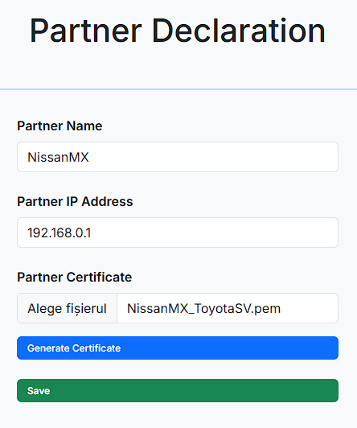
Creating and managing connections with partners (suppliers/customers)
Automatic systems to send/receive files and assign them to the corresponding workflow rules
Predefined workflows to map documents based on needs

Slide 9
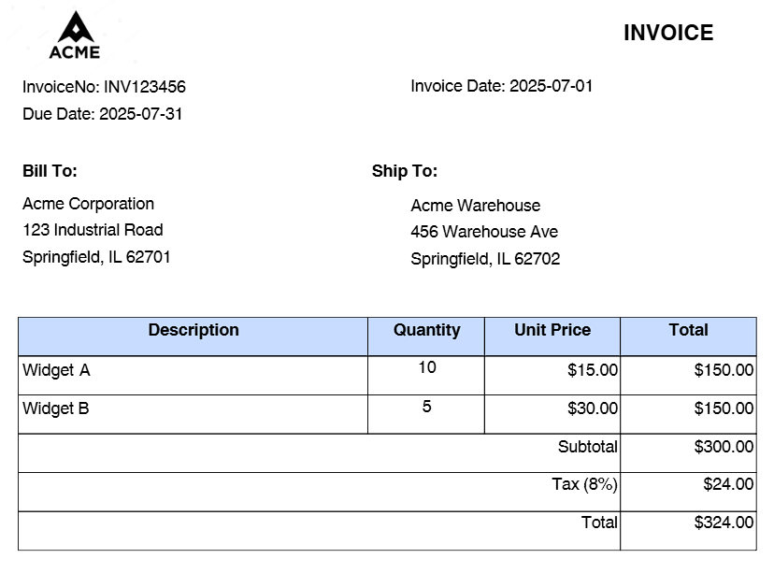
EDI FILES
ISA*00* *00* *ZZ*SENDERID *ZZ*RECEIVERID *250701*1200*U*00401*000000001*0*P*>~
GS*IN*SENDERID*RECEIVERID*20250701*1200*1*X*004010~
ST*810*0001~
BIG*20250701*INV123456*20250601*PO1234567~
N1*BT*Acme Corporation*92*123 Industrial Road, Springfield, IL 62701~
N1*ST*Acme Warehouse*92*456 Warehouse Ave, Springfield, IL 62702~
IT1*1*10*EA*15.00**VP*Widget A~
IT1*2*5*EA*30.00**VP*Widget B~
TDS*32400~
CAD*PP***Carrier Name~
ISS*15~
CTT*2~
SE*12*0001~
GE*1*1~
IEA*1*000000001~

Slide 10
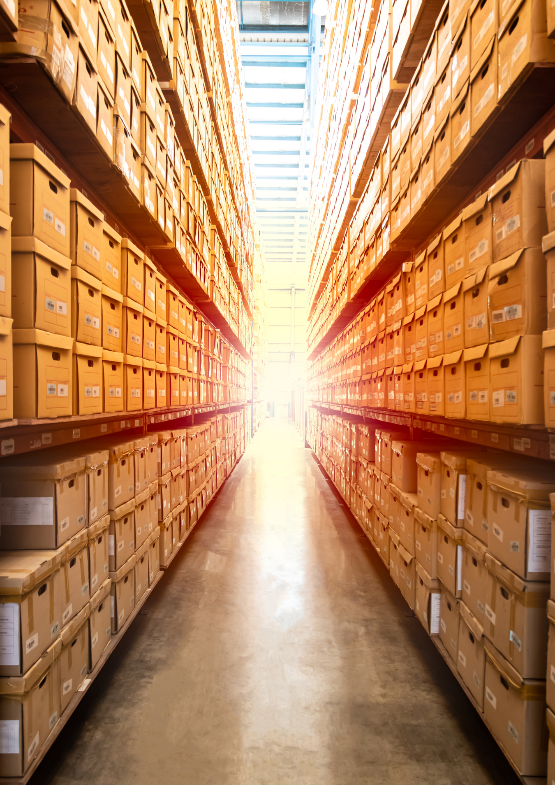
CONCLUSIONS
Difficulties:
Niche industry
Infrastructure
Future Work:
User customization
Server integration
Built-in conversion
Encryption & Decryption

Slide 11
BACHELOR THESIS
THANK YOU
FOR YOUR ATTENTION
Supervisor: Lect. Dr. Tudor-Dan Mihoc
Author: Iaguța Alen-Mihael

